Slide 1
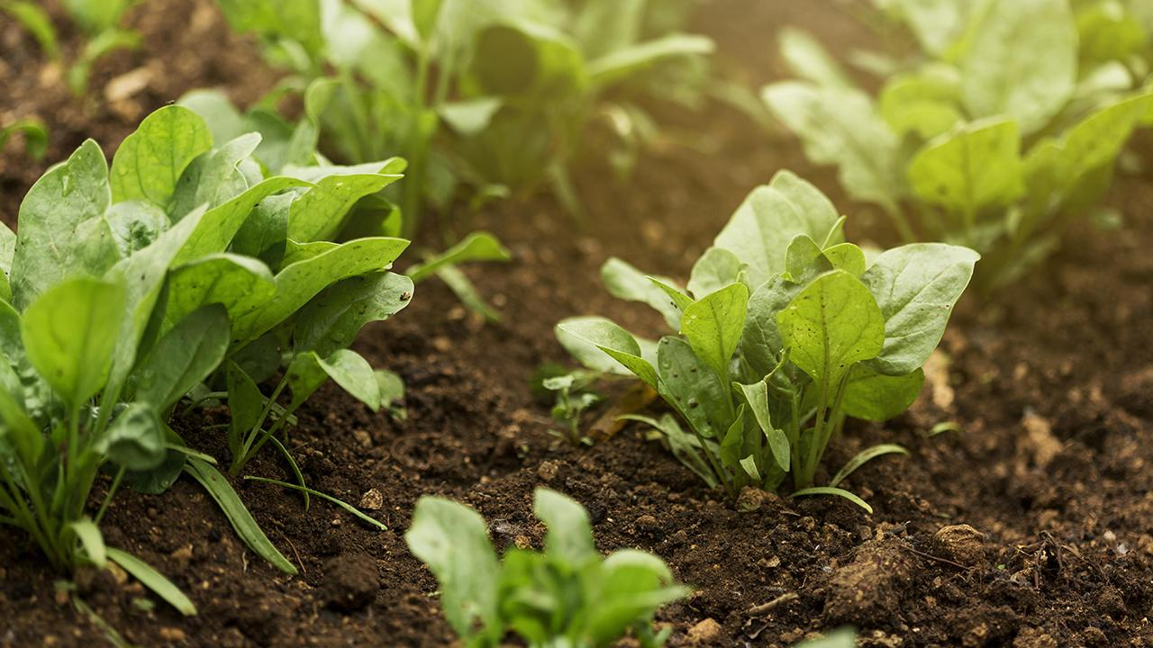
KrishiMitra: Your Agricultural Support Partner
Optimizing Crop Selection through AI and Web Tools

Slide 2
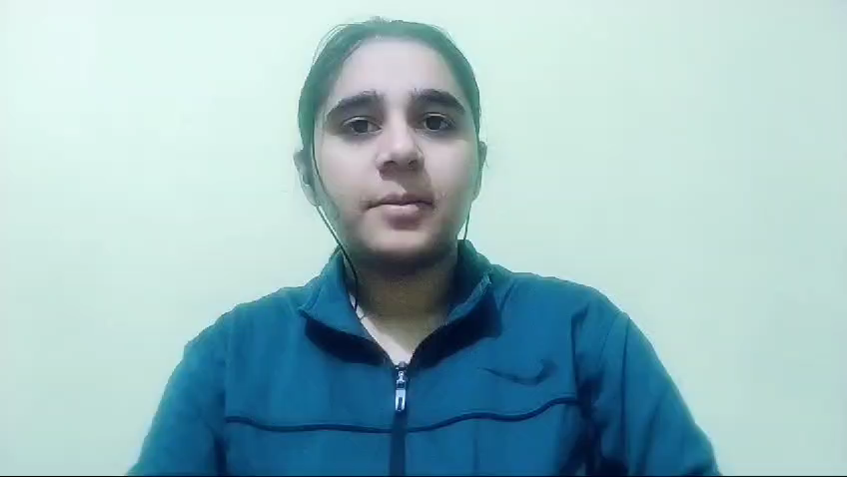

Slide 3
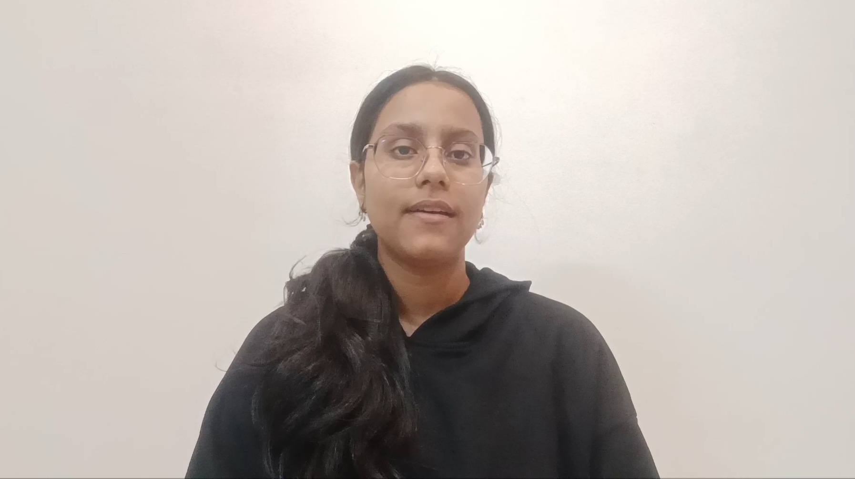

Slide 4
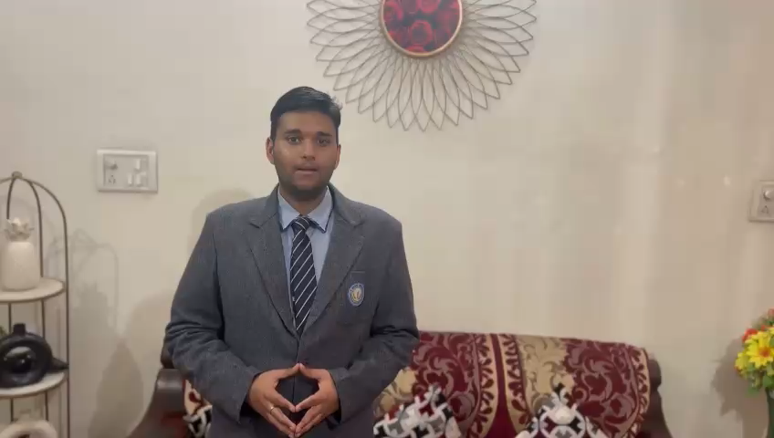

Slide 5
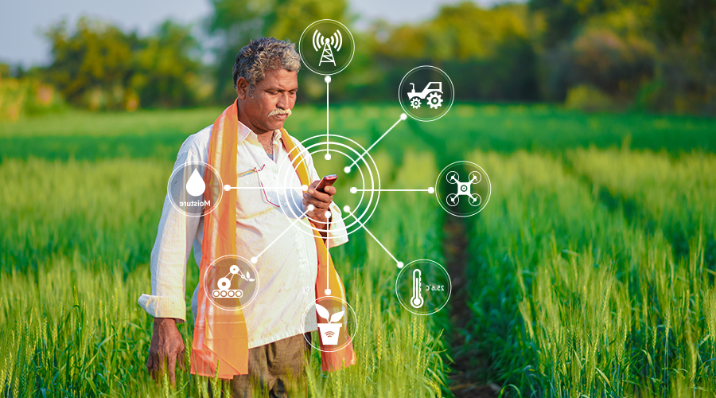

01
About the Project
Enabling Indian farmers to make informed decisions about crop selection, ensuring higher yields, sustainability, and increased income
Notes:
Indian farmers face challenges in choosing the right crops for their land and climate, leading to lower yields and unsustainable farming. Many also struggle with marketing their produce and accessing fair prices. Empowering them with knowledge, tools, and digital skills is key to transforming their livelihoods. Keeping the same in mind, we created an AI model to help them solve the problem. The goal was to leverage AI to optimise crop selection, improve farming practices, enhance market access, and promote digital literacy for sustainable and profitable agriculture. After learning more about the users, which in this case are the farmers, we shaped a few ideas. The one that stood out the most was creating a website that would act as a one-stop solution to most of their problems. We will now elaborate more on this website and how it works.

Slide 6
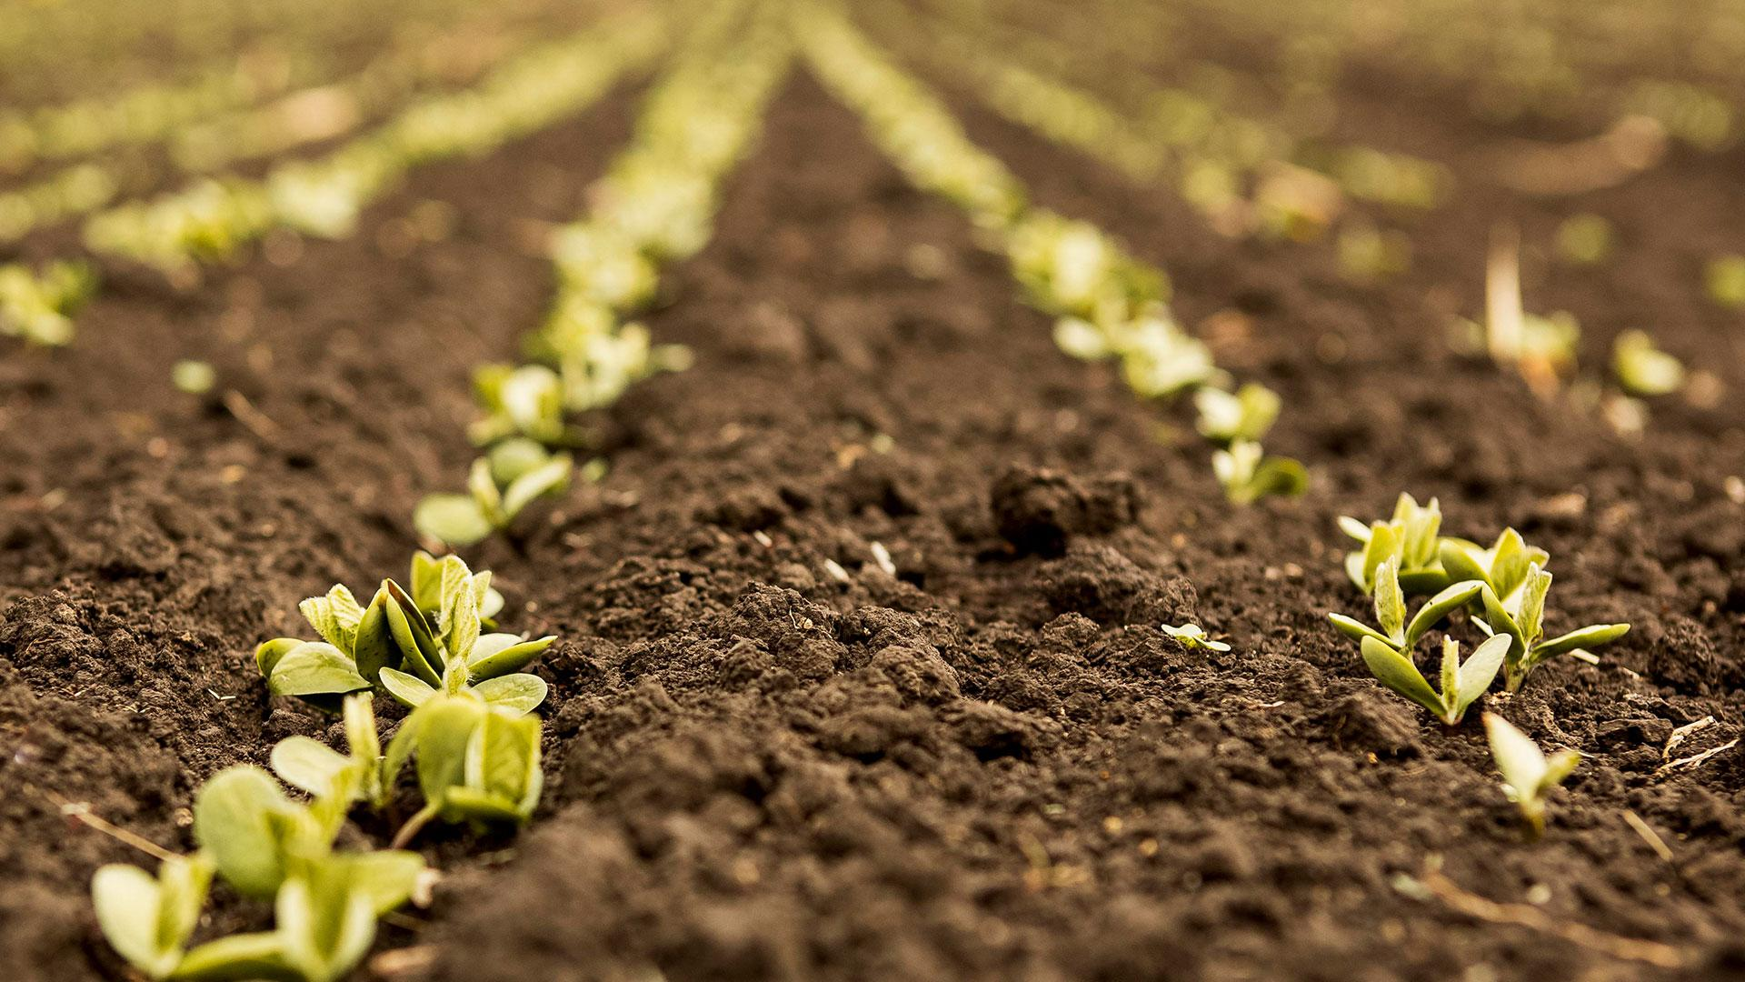
02
The Website

Slide 7
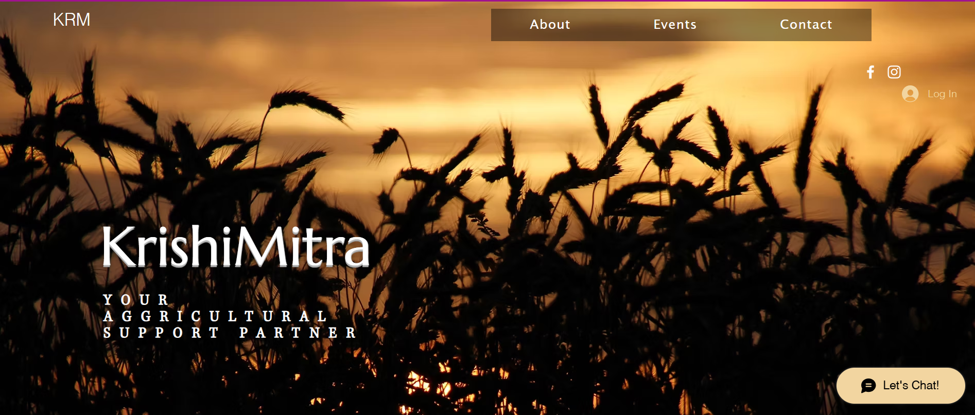
Notes:
This is how the website currently looks. We aimed to create a simple, user-friendly interface to ensure smooth navigation. The website is integrated with a chatbot that analyzes the working conditions of the farmers and provides solutions to optimize their produce using the provided data.

Slide 8
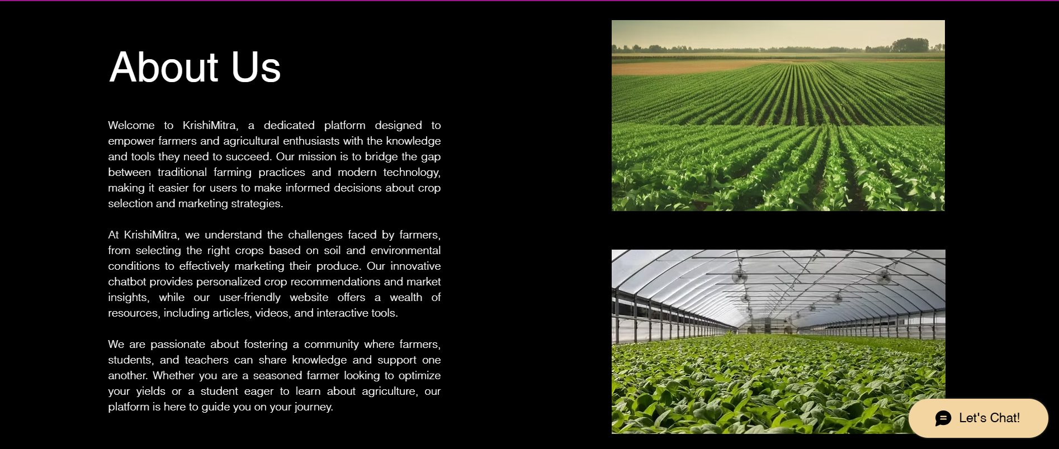

Slide 9
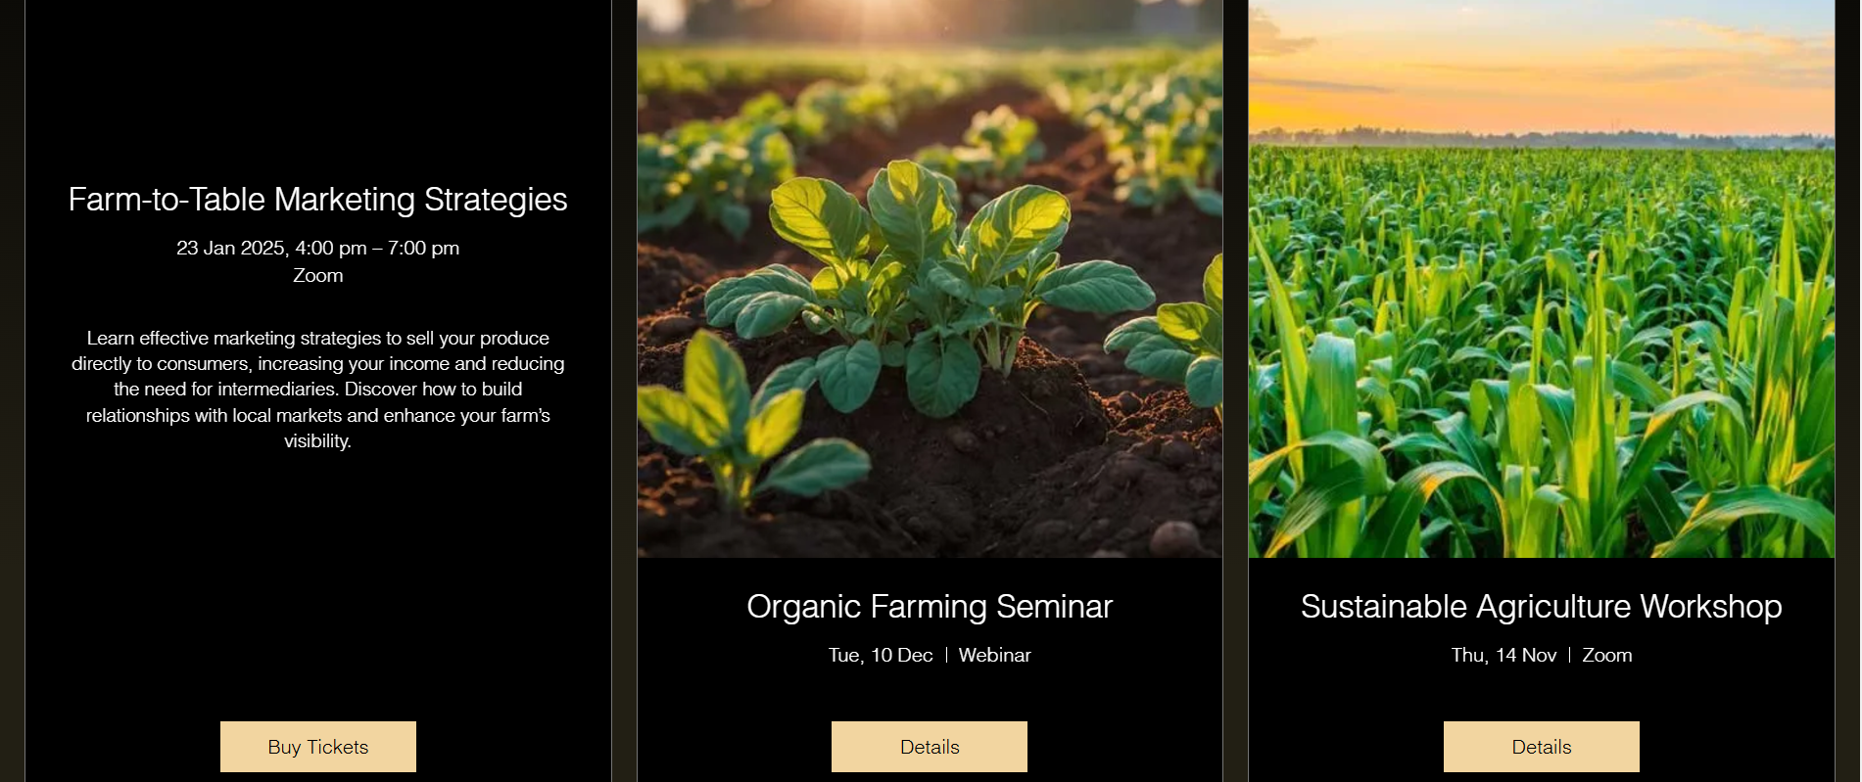
Notes:
An important feature of the website is the events page. Here the users can register themselves for any upcoming webinar or zoom session where they can learn more about marketing strategies and modern and sustainable farming techniques.

Slide 10
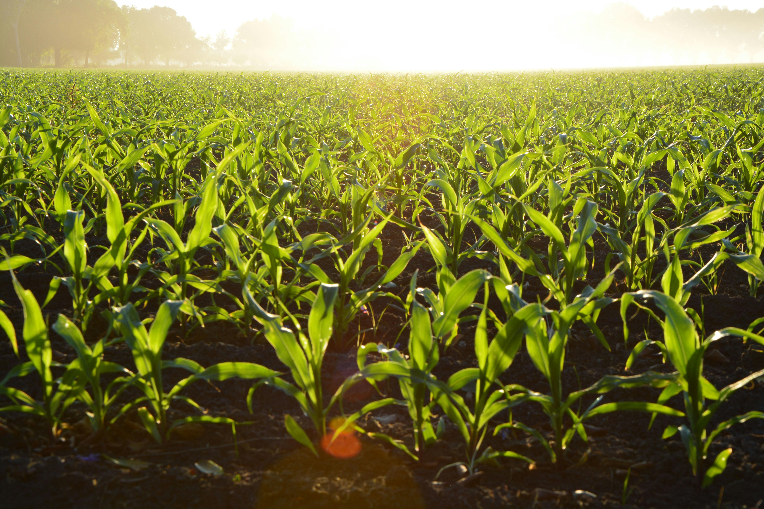
03
The Chatbot

Slide 11
Screenshots code wale
Notes:
We designed the chatbot using our prior knowledge of Python. Here is a preview of the code and how it works

Slide 12
Chatbot in website wala screenshot

Slide 13

Why we think it’s a good solution
Notes:
We think the farmers would find this model useful because it simplifies decision-making by providing AI-driven advice on crop selection tailored to their land and local climate. This can lead to better yields and more sustainable farming practices. Additionally, by helping them market their produce effectively and access fair prices, our solution directly addresses their key challenges. The inclusion of digital tools further empowers them, making farming smarter and more profitable in a tech-driven world.

Slide 14
Future Roadmap
Expanding database to include more crops and regions
Adding a marketplace for farmers to sell directly
Integrating weather prediction models
Developing a mobile app
Notes:
We plan to improve our model and here is a list of a few ways in which we can achieve that. Expanding the database to include more crops and regions would help improve the accuracy of the model. It would also improve inclusivity. We also wish to integrate weather prediction models and add a marketplace for farmers to sell directly helping reduce dependency on middlemen. Developing a mobile app is another goal we wish to achieve.

Slide 15
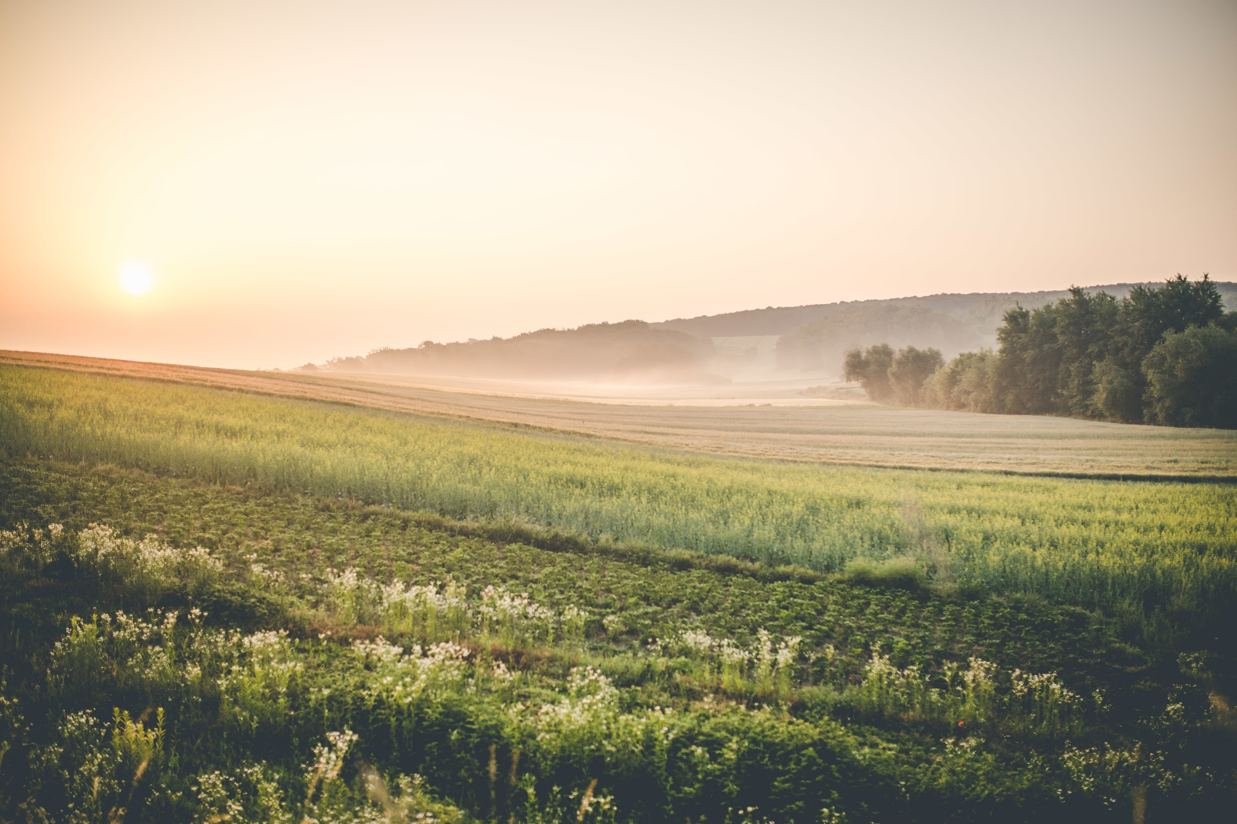
Thanks!

